Slide 1






Machine Learning
PROF.
LE ANH CUONG

Slide 2
Goal of creating a machine learning model
 | kNN | Linear Regression | Naive Bayes Classifier | Decision Tree
Types of Learning | Supervised | Supervised | Supervised | Supervised
Types of Model | Non-parametric | Parametric | Probabilistic | Non-probabilistic
Goals | To classify or predict new data points | To predict a continuous value for a new data points | To classify new data points | To classify or predict new data points

Slide 3
The methods/Algorithms and the learning criteria
 | kNN | Linear Regression | Naive Bayes Classifier | Decision Tree
Learning Criteria | - The model classifies individual point by a majority voting of its neighbors, measured by a Distance metrics, such as Euclidean distance, Manhattan distance, or cosine similarity. - Minimize the distance between the new data point and its K nearest neighbors. | - The model finds the best fits line (equation) for predicting the target variable for new data points. - Minimizing the sum of squared errors (SSE) between predicted and the actual value, | - The model is a probabilistic classification algorithm which uses Bayes’s theorem which calculate the probability of an event happening to classify data points. - The learning criterion is to maximize the posterior probability of the class, given the predictor variable. | - The model works by recursively partitioning the data into smaller subsets until each subset contains only data points from a single class. - The learning criterion is to maximize the information gain at each split which is a measure of how much purity of the data improved by splitting.

Slide 4
Types of problems, data, and advantages and disadvantages.
 | kNN | Linear Regression | Naive Bayes Classifier | Decision Tree
Types of Problems | Classification | Regression | Classification | Classification & Regression
Data | - Categorical, and numerical | - Numerical | - Categorical, and numerical | - Categorical, and numerical
Strength | - Simple to understand and implement. - Can be used for both classification and Regression. - Robust to outliers. | - Simple to understand and interpret. - Can be used for both classification and Regression. - Efficient to train and predict. | - Simple to understand and implement. - Can be used for both classification and Regression. - Efficient to train and predict. | - Complex relationships between predictor and target variables. - Can be used for both classification and Regression.
Weakness | Computationally expensive for large datasets. Sensitive to choice of distance metric and the value of k. | Sensitive with outliers in case the relationship between predictor and the target variables is linear. | Sensitive with outliers in case the predictor variables are independent. | Can be overfit to the training data. Sensitive to outliers.

Slide 5


Feature Selection
Features are redundant or less important for the prediction
feature selection process is applied
simplify the model
reduce noise ≠ dimensionality reduction

Slide 6

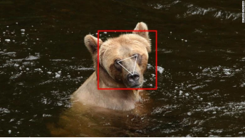
Feature Selection
Example: To predict if an image is an animal or human, you can look at various input parameters like face shape, ear position, body structure, etc. You may prioritize face shape and ignore the shape of the eyes.

Slide 7
Feature Selection
Some feature selection heuristics:
Variance Thresholds
Correlation Thresholds
Genetic Algorithms (GA)
Honorable Mention: Stepwise Search

Slide 8
Bias
Noise
Noise
Bias
Noise
Variance
Overfitting
Variance
Bias
Variance
Variance
Noise
Noise
Bias

Slide 9
Good fitting/Robust
Balance between
bias and variance

Slide 10
Underfitting
High bias
Low variance

Slide 11

Underfitting
Reason
Contain noise
Model is too simple
Size is not enough

Slide 12
Underfitting
Ways to tackle
Increase features
Increase model complexity
Reduce noise
Increase time training data

Slide 13
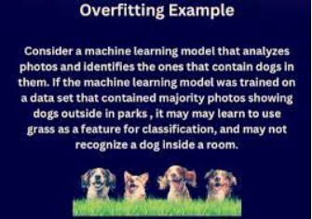
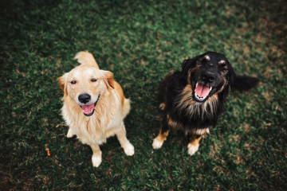

Overfitting

Slide 14
Overfitting
Low bias
High variance
validation accuracy decreases
with the number of epochs

Slide 15
Overfitting
Reason
Contain noise
Model is too complex
Size is not enough

Slide 16

Detecting Overfitting
Cross Validation (K-Fold)
Steps:
1.Keep one subset as the validation data and train the machine learning model on the remaining K-1 subsets.
2.Observe how the model performs on the validation sample.
3.Score model performance based on output data quality.

Slide 17
Avoid Overfitting
Train with more data
Data augmentation
Feature selection
Early stopping
Regularization
Ensemble methods

Slide 18
Avoid Overfitting
Train with more data

Slide 19
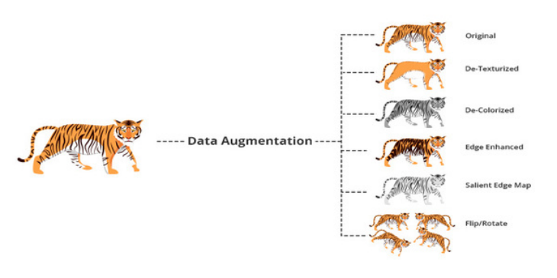
Avoid Overfitting
Data augmentation

Slide 20

Avoid Overfitting
Feature selection

Slide 21
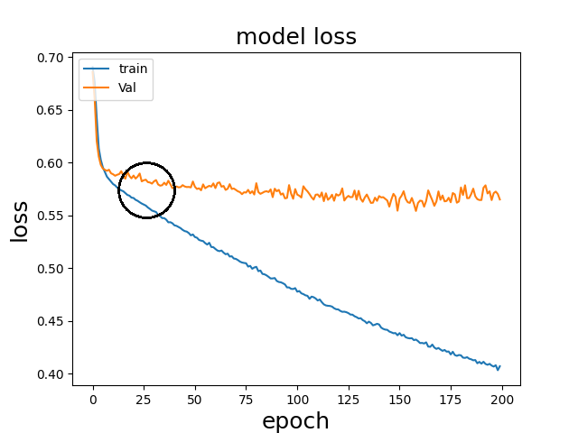
Avoid Overfitting
Early Stopping

Slide 22
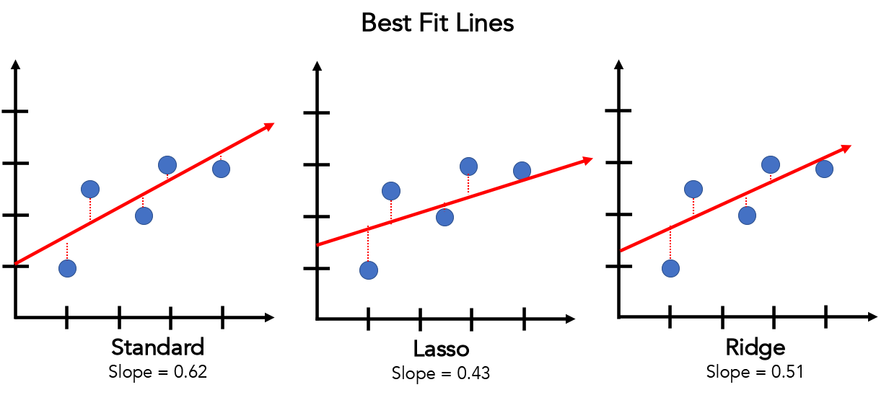
Avoid Overfitting
Regularization

Slide 23
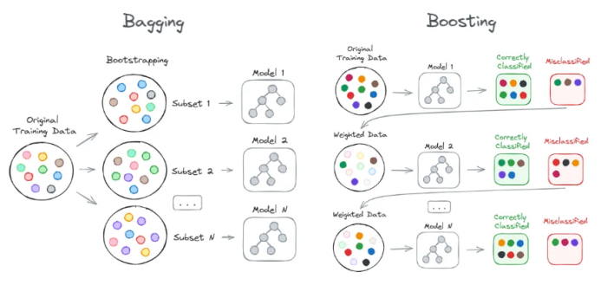
Avoid Overfitting
Ensemble methods

Slide 24
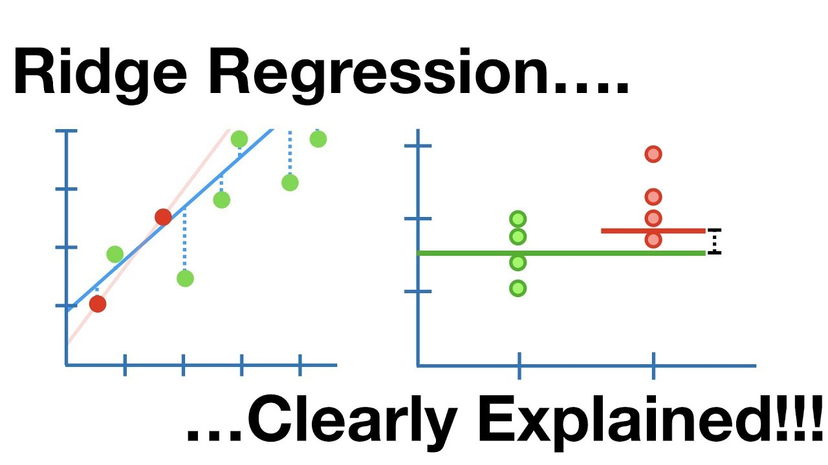
Avoid Overfitting
Regularization

Slide 25
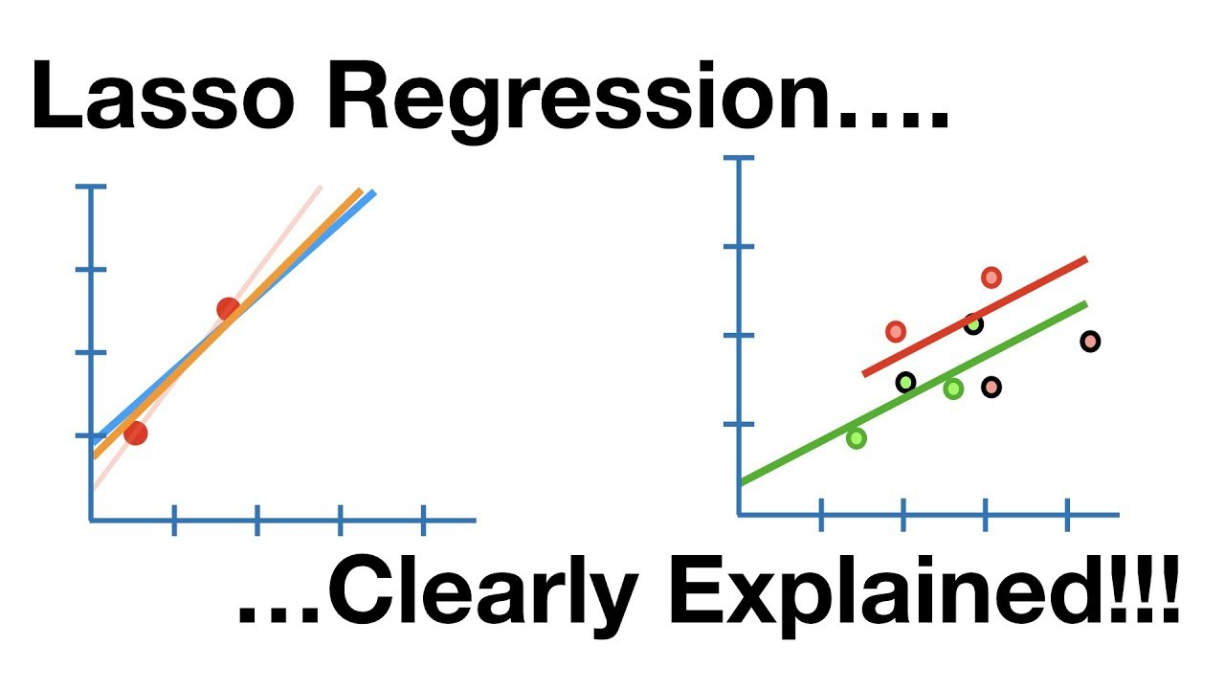
Avoid Overfitting
Regularization

